Slide 1
Effects of age on navigation strategy
期刊：Neurobiology of Aging
作者：M. Kirk Rodgers, Joseph A. Sindone III, Scott D. Moffat
學生：林怡儒 M10421223

Slide 2
egocentric
Sometimes called response or route strategy.
A strategy in which an individual remembers directions or a route based on a frame of reference centered on the individual, independent of absolute position.

Slide 3
allocentric
It known as a cognitive map or place strategy
And relies on a frame of reference external to the individual, based, for example, on using a cognitive map with external reference points.

Slide 4
Introduction
Young adult humans outperform their older counterparts on spatial navigation measures has now been demonstrated in numerous studies.
It has been suggested that the hippocampus plays a role in allocentric spatial processing whereas other regions, most notably the parietal cortex and caudate nucleus, may play a more prominent role in egocentric spatial processing.
One study retrospectively asked younger and older human participants how they solved a navigation task and found that selfreported allocentric strategy decreased with age
Several functional neuroimaging studies have now demonstrated that older adult humans show reduced or absent hippocampal activation in performing naviga.tion tasks compared with younger adults.
Magnetic resonance imaging (MRI) study has shown that hippocampal volume is positively correlated with navigation performance in the young but not in the elderly.

Slide 5
Methods
Participants
45 older adults (aged 55 to 85)
54 younger adults (aged 18 to 35)
All participants were free of psychological, neurological, or severe cardiac disorders as revealed by detailed self-report of medical history, scored 26 or higher on the Mini Mental Status Examination (MMSE), scored better than 20/40 (corrected) on visual acuity tests, and spoke English as their native language.

Slide 7
Computer experience
Blood pressure

Slide 8
Nausea assessment
Virtual environments

Slide 9
Methods
virtual Y-maze strategy assessment (vYSA)
In order to determine pre-existing preferences for allocentric vs. egocentric strategy use, a virtual Y-maze strategy assessment was created.
Each arm of the maze terminated with a circular goal area.
The vYSA consisted of 5 blocks of 2 parts each：training and probe
During the training portion of each block, participants completed multiple trials starting at a given location and terminating in 1 of the 3 circular goal areas.
For the probe trial of each block, participants were placed at a third position that was neither the starting location nor the goal location for preceding training trials

Slide 10
Methods
Training continued until participants reached a criterion level of 5 consecutive successful learning trials.
The vYSA probe trial was designed to determine allocentric or egocentric strategy preference.
In order to increase the reliability of our vYSA and ensure stability of strategy preferences, participants completed 5 separate blocks of vYSA training and probe trials and were required to choose the same strategy for at least 4 of the 5 blocks in order for that participant to be classified as preferring 1 strategy over another.

Slide 11
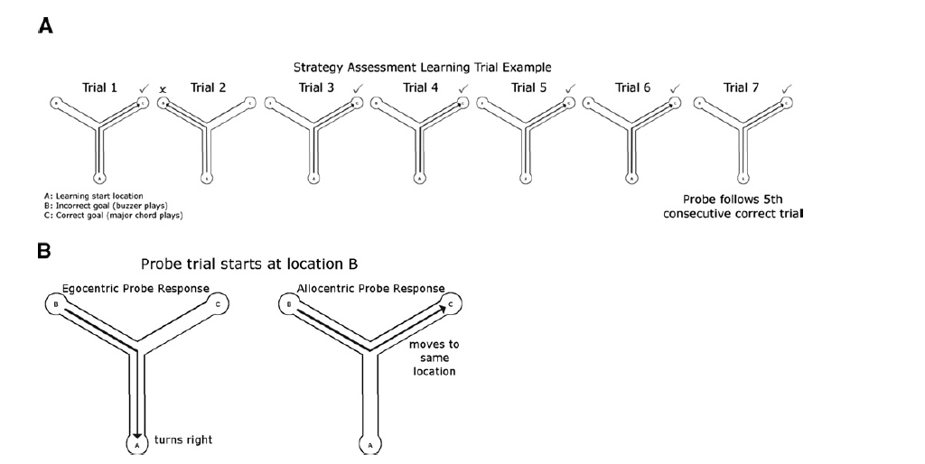

Slide 12
Methods
virtual Morris water task (vMWT)
In order to determine pre-existing preferences for allocentric vs. egocentric Participants completed 10 learning trials followed by 1 probe trial.
For all trials, participants navigated through a circular pool contained in a large, nonsymmetrical virtual room.
In the learning trials, participants were placed in the environment randomly at 1 of 6 potential starting positions inside the pool area. Participants were instructed that their goal was to find a hidden platform.
The dependent variable ：the latency to reach the platform on each trial
In the probe trial, the platform was removed and participants began at 1 of the 6 starting locations and were instructed to locate the platform.
The dependent variable ：the number of platform intersections

Slide 13
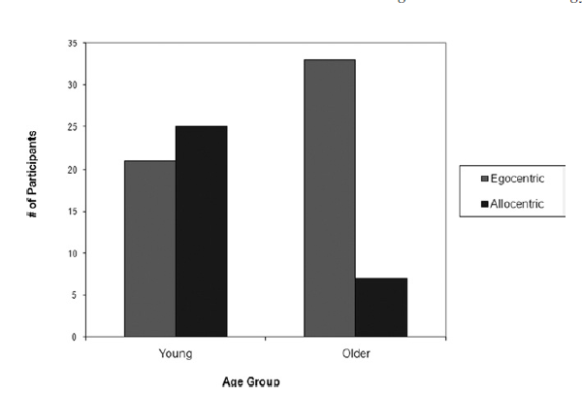
Results
strategy preference by age group on the Y-maze strategy assessment (vYSA).
82%
54%
46%
18%
Strategy selection differed as a function of age group → Ｘ²=12.43, p < 0.001
Older adults overwhelmingly preferred an egocentric strategy
younger adults showed a modest preference for allocentric strategy

Slide 14
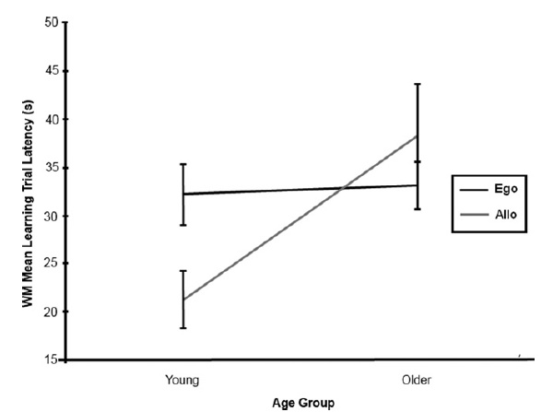
Results
learning
A main effect for age
A significant interaction between age and strategy preference
F(1,85) = 4.78, p = 0.03.
An interaction between age group and sex approached significance.
F(1,85)=3.63,P=0.06

Slide 15
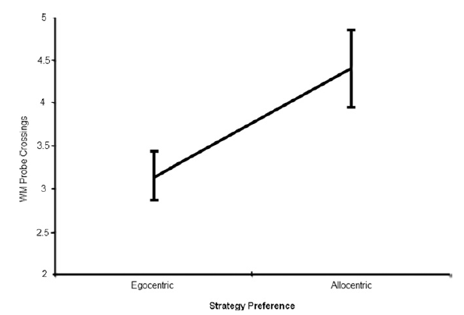
Results
probe
Participants preferring an egocentric strategy
There was no main effect for age.
There was no interaction between age group and strategy preference, F(1,85) = .69, p = 0.97, sex and strategy preference, F(1,85) = 3.65, p = 0.06, or age group, sex, and strategy preference, F(1,85)=.434, p = 0.512.

Slide 16
Results
Older adults took more time to complete the water maze than younger adults.
Older adults were much more likely to choose an egocentric strategy than an allocentric strategy, while younger adults were more equally distributed between allocentric and egocentric strategy preferences.
Researchers have speculated that young individuals may solve navigation tasks using an allocentric strategy whereas older individuals may use a response or egocentric strategy.
Ultimately, results from the present study may lead to specific strategy training interventions that could ameliorate some of the age-related deficits in navigation.

